Slide 1
FRC Robot Electronics

Slide 2
NI RoboRIO
Status LEDs
USB Device
USB Host
12v Power
Ethernet
SPI
Power: Green=OK
Amber=Brownout
Red=Fault
Status: On=Booting
Off=OK
Blinking=Error
Radio: NA
Comm: Off=None
Red Solid=No Code
Red Blink=E-Stop
Green Solid=OK
Mode: Off= Disabled
Green=Autonomous
Amber=Teleop
Red=Test
RSL: Off=Robot Off
On=Robot Disabled
Blinking=Robot Enabled
CAN
I2C
RS-232
DIO (10)
MXP
PWM (10)
Accelerometer
CAN = Controller Area Network
DIO = Digital Input / Output
I2C = Inter-Integrated Circuit
MXP = myRIO Expansion Port
PWM = Pulse Width Modulation
RS232 = Serial Port Standard
RSL = Robot Signal Light
SPI = Serial Peripheral Interface
Dimensions:
5.7” x 5.6” x 1.3”
RSL
Relay (4)
Analog IN (4)
Pin Spacing = 0.1”
I/O Spacing = 0.3”
12-bit ADC with 0-5v range

Slide 3
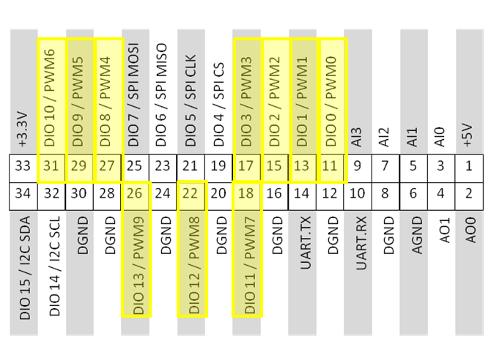
RoboRIO MXP
myRIO Expansion Port
Shared:
10 - PWM Outputs
(Disabled when Robot is Disabled)
16 - DIO
1 - I2C Port
1 - SPI Port
4 - Analog Inputs
2 - Analog Outputs
1 - RS-232 Port

Slide 4
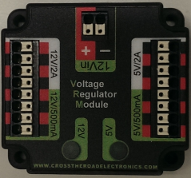
Voltage Regulator Module
12v Power
Radio Power
Custom Circuits
Camera Power
Custom Circuits

Slide 5
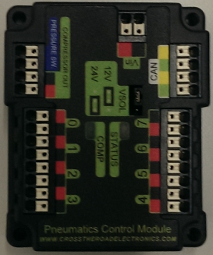
Pneumatics Control Module
12v Power
Pressure Switch Input
CAN
Compressor Relay Output
Solenoid (4)
Solenoid (4)

Slide 6
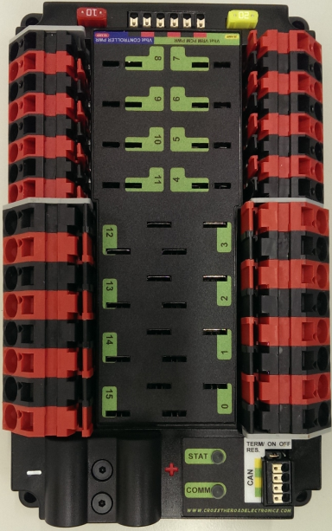
Power Distribution Panel
(4)
20/30 amp Circuits
(4)
40 amp Circuits
CAN
VRM
Voltage Regulator Module
PCM
Pneumatic Control Module
+ 12 Volts
RoboRIO
-12 Volts
20/30 amp Circuits
(4)
40 amp Circuits
(4)

Slide 7
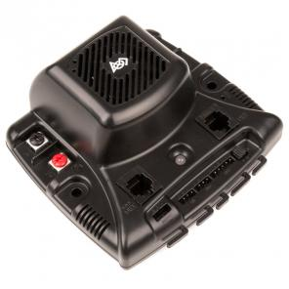
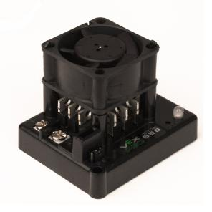
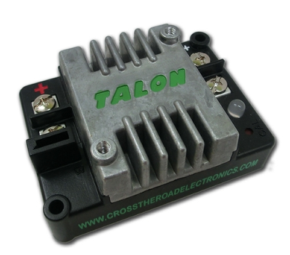
Motor Controllers
Jaguar
VEX Robotics
15 Khz
Talon
Cross the Road Electronics
15 Khz
Victor 888/884
VEX Robotics
1 Khz
Interface: PWM
CAN
Interface: PWM
Interface: PWM
(CAN = Controller Area Network)
WPILib Class: Jaguar
WPILib Class: Talon
WPILib Class: Victor

Slide 8
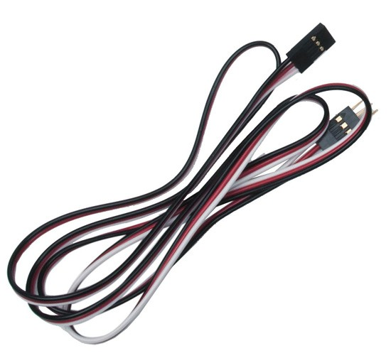
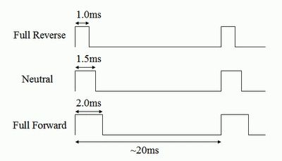
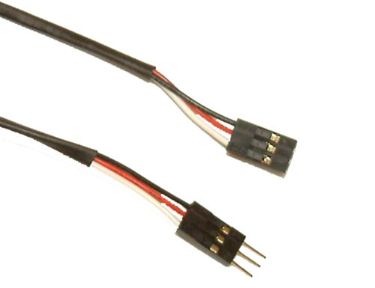
PWM Cable
Black: Ground
Red: +5 volts
White: Signal

Slide 9
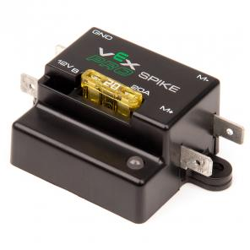
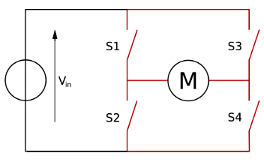
Spike H-Bridge Relay
Control |  | OUTPUTS
Forward | Reverse | M+ | M- | Indicator | Motor Function
White | Red
0 | 0 | GND | GND | Orange | OFF / Brake
1 | 0 | +12v | GND | Green | Forward Rotation
0 | 1 | GND | +12v | Red | Reverse Rotation
1 | 1 | +12v | +12v | Off | OFF / Brake
WPILib Class: Relay

Slide 10
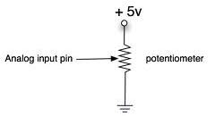
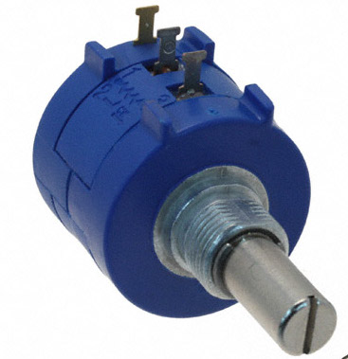
Potentiometer
(PWM Red)
(PWM White)
(PWM Black)
Pin Color
1 Red +
2 White
3 Black -
Pin Color
1 Black -
2 White
3 Red +
WPILib Class: AnalogChannel
Increasing
Increasing

Slide 11
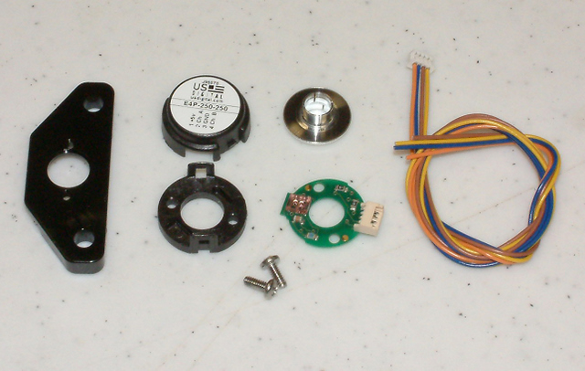
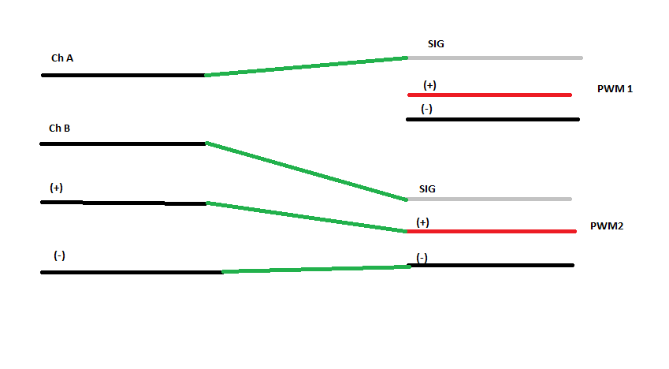
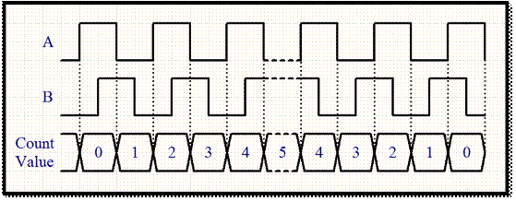
Quadrature Encoder
WPILib Class: Encoder

Slide 12
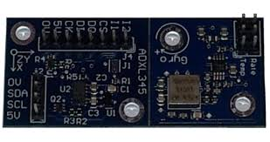
Gyro/Accelerometer
SPI Port
(4 Digital Inputs)
PWM Black
PWM Red
PWM White
Accelerometer
Gyro
I2C Port
WPILib Class: Accelerometer
WPILib Class: Gyro

Slide 13
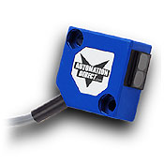
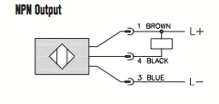
Photoelectric Sensors
+12/24 Vdc
Digital Input Signal
-12/24 Vdc
Photoelectric Sensors
Type | Range (Inches) | Range (mm)
Diffuse | 23.62 | 600
Diffuse with Background Suppression | 0.59 to 5.91 | 15 to 150
Polarized Reflective | 79 | 2000
Through-beam | 236 | 6000
WPILib Class: DigitalInput

Slide 14
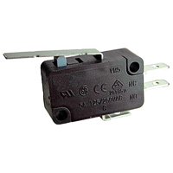
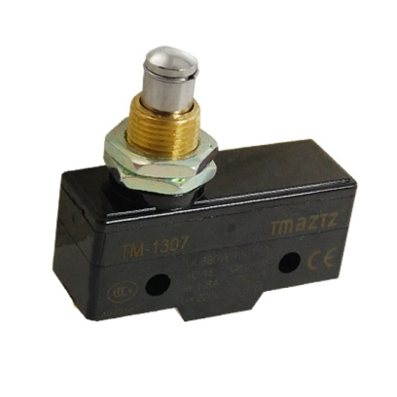
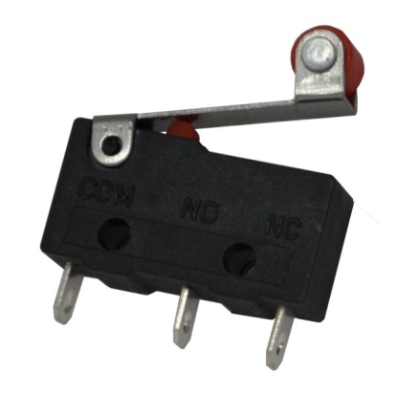
Limit Switches
Used to detect limit of travel
or stop positions.
WPILib Class: DigitalInput

Slide 15
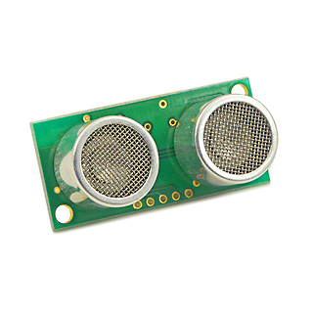
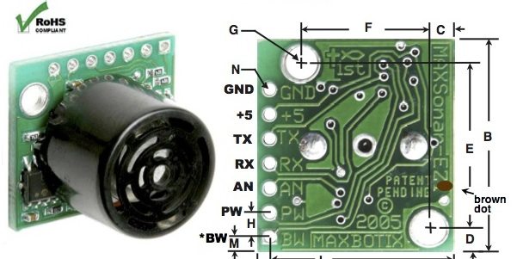
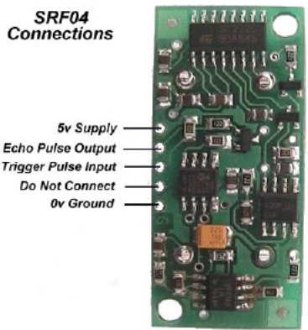
Ultrasonic Rangefinder
Analog
Ping-Response
(Digital Input and Output)
GND - PWM Black
+5 - PWM Red
AN - PWM White
WPILib Class: AnalogChannel
WPILib Class: Ultrasonic

Slide 16
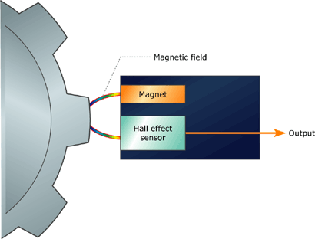
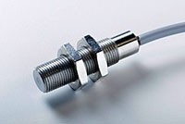
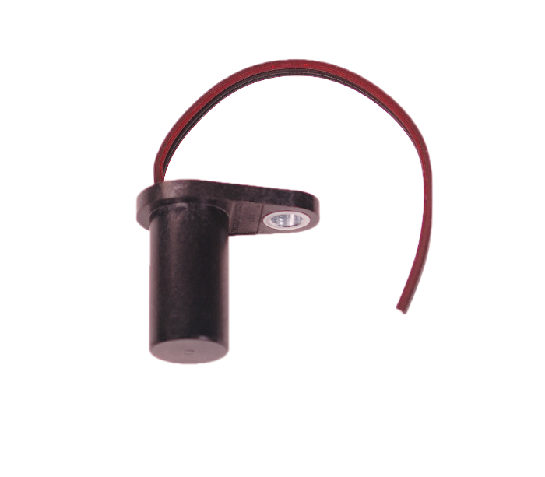
Hall Effect Sensors
WPILib Class: GearTooth

Slide 17
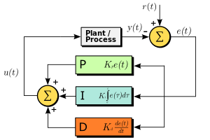
PID Controller
Proportional: Present Error
Integral: Accumulation of Past Errors
Derivative: Prediction of Future Error

