Slide 1
2015 FRC Control System
101010 = MOL = DUK

Slide 2
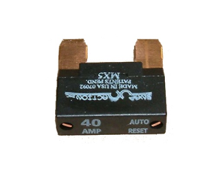
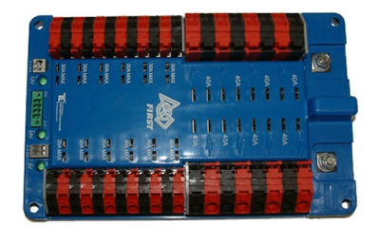
2014 Power Distribution Board
(6)
20/30 amp Circuits
(4)
40 amp Circuits
12 Volt
(DAP Bridge)
+ 12 Volts
24 Volt
(cRIO)
-12 Volts
5 Volt
(Camera)
20/30 amp Circuits
(6)
40 amp Circuits
(4)

Slide 3
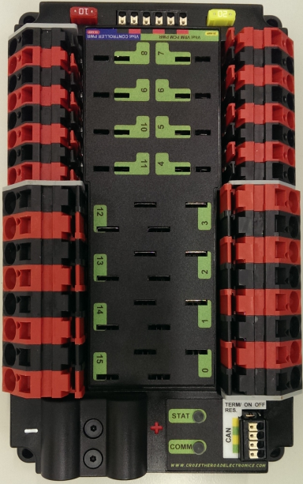
2015 Power Distribution Panel
(4)
20/30 amp Circuits
(4)
40 amp Circuits
CAN
VRM
Voltage Regulator Module
PCM
Pneumatic Control Module
+ 12 Volts
RoboRIO
-12 Volts
20/30 amp Circuits
(4)
40 amp Circuits
(4)

Slide 4
2014 NI 4-Slot cRIO
Analog Module
Solenoid Module
(Optional)
Serial Port
Optional:
Analog Module
Digital Module
Solenoid Module
24v DC Power
Ethernet Port
Digital Module

Slide 5
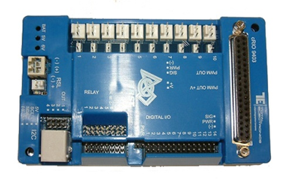
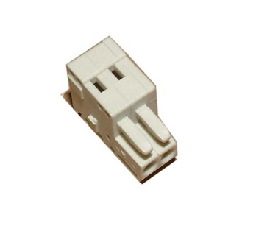
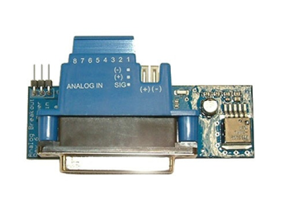
Digital Side Car – Analog Breakout
PWM Outputs (10)
(Motor Controllers and Servos)
37-pin Connector
(cRIO Digital Module)
12v Power
Input
12v Power
Input
Robot Signal
Light
Analog Inputs (8)
Battery Voltage
Jumper
Relay Status
LEDs
I2C Header and Connector
Digital Input/Output (14)
Relay Output (8)
Connector (DB25)
(cRIO Analog Module)
12-bit ADC with range of -10 to +10 Vdc
(With 0 -5 Vdc input ADC counts = 0 to 1023)

Slide 6
2015 NI RoboRIO
Status LEDs
USB Device
USB Host
12v Power
Ethernet
SPI
Power: Green=OK
Amber=Brownout
Red=Fault
Status: On=Booting
Off=OK
Blinking=Error
Radio: NA
Comm: Off=None
Red Solid=No Code
Red Blink=E-Stop
Green Solid=OK
Mode: Off= Disabled
Green=Autonomous
Amber=Teleop
Red=Test
RSL: Off=Robot Off
On=Robot Disabled
Blinking=Robot Enabled
CAN
I2C
RS-232
DIO (10)
MXP
PWM (10)
Accelerometer
CAN = Controller Area Network
DIO = Digital Input / Output
I2C = Inter-Integrated Circuit
MXP = myRIO Expansion Port
PWM = Pulse Width Modulation
RS232 = Serial Port Standard
RSL = Robot Signal Light
SPI = Serial Peripheral Interface
Dimensions:
5.7” x 5.6” x 1.3”
RSL
Relay (4)
Analog IN (4)
Pin Spacing = 0.1”
I/O Spacing = 0.3”
12-bit ADC with 0-5v range

Slide 7
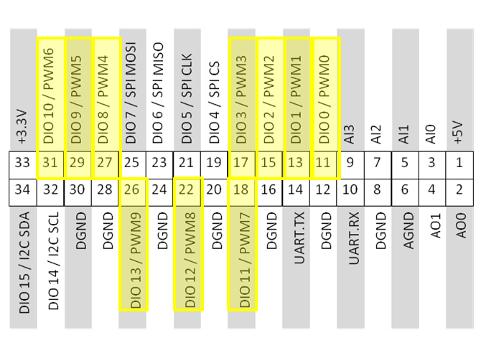
2015 RoboRIO MXP
myRIO Expansion Port
Shared:
10 - PWM Outputs
(Disabled when Robot is Disabled)
16 - DIO
1 - I2C Port
1 - SPI Port
4 - Analog Inputs
2 - Analog Outputs
1 - RS-232 Port
http://www.usfirst.org/roboticsprograms/frc/blog-myRIO-Expansion-Port- Whats-the-Deal.

Slide 8
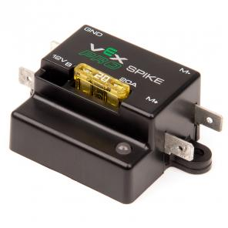
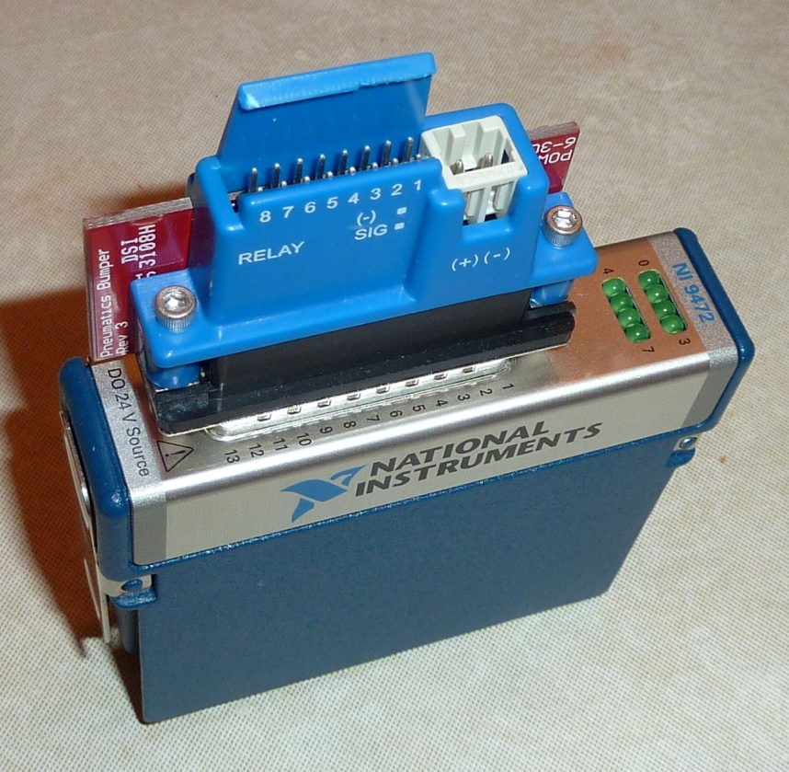
2014 Pneumatics
Solenoid Module & Breakout
Spike Relay Digital Input
Relay Outputs (8)
(Max current/channel = 0.75A)
(Maximum Total = 21W)
12/24v Power
Input

Slide 9
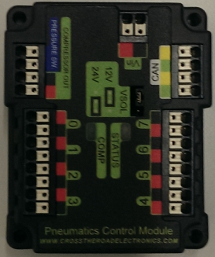
2015 Pneumatics Control Module
12v Power
Pressure Switch Input
CAN
Compressor Relay Output
Solenoid (4)
Solenoid (4)

Slide 10
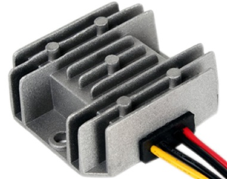
2014 Power Converter
12v –to-5v

Slide 11
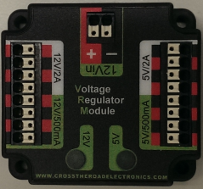
2015 Voltage Regulator Module
12v Power
Radio Power
Custom Circuits
Camera Power
Custom Circuits

Slide 12
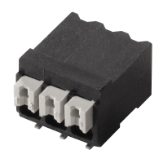
Weidmuller LSF Connectors
For best results:
Wire should be 16AWG to 24AWG (consult rules to verify required gauges for power wiring)
Wire ends should be stripped approximately 5/16“
To insert or remove the wire, press down on the corresponding "button" to open the terminal
After making the connection check to be sure that it is clean and secure:
Verify that there are no "whiskers" outside the connector that may cause a short circuit
Tug on the wire to verify that it is seated fully. If the wire comes out and is the correct gauge it
needs to be inserted further and/or stripped back further.

Slide 13
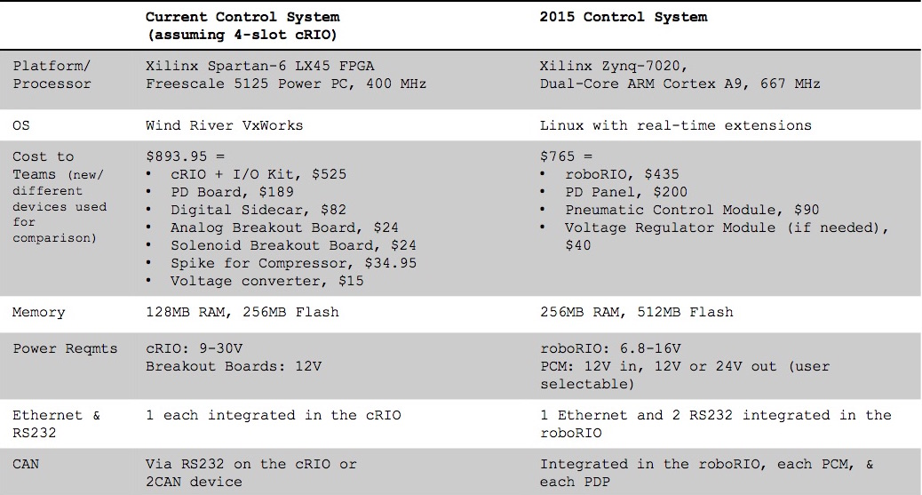
Control System Comparison

Slide 14
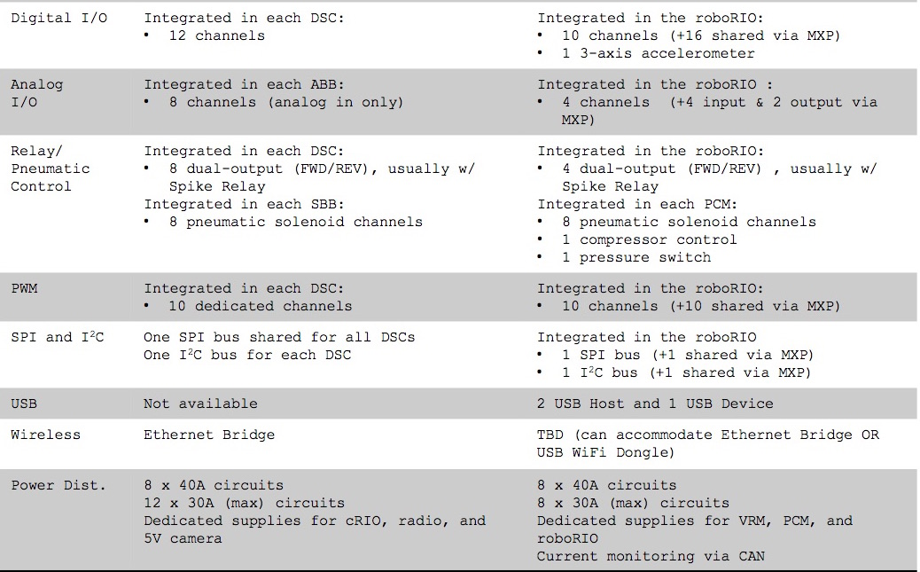
Control System Comparison

Slide 15
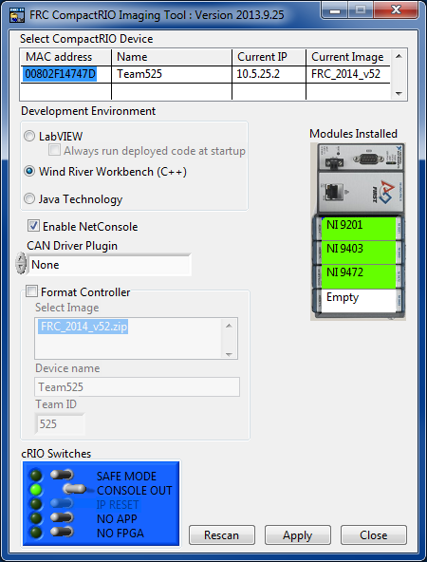
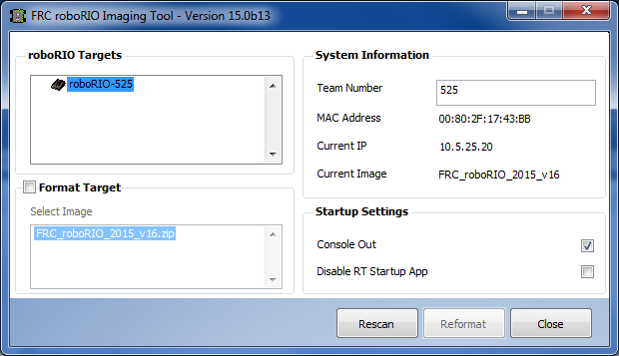
RoboRIO Imaging Tool

Slide 16
RoboRIO Networking
mDNS
Multicast Domain Name System (mDNS) is a system which allows for resolution of host names to IP addresses on small networks with no dedicated name server. (roboRIO-TEAM.local)
The FRC Driver Station, LabVIEW, and the Eclipse plugins for C++ and Java are all programmed to discover your roboRIO using mDNS protocol. This means the roboRIO can be detected regardless of the interface or IP being used.
USB
When using the USB interface, no setup is required. The roboRIO driver will automatically configure the IP address of your computer and the roboRIO.
Wireless
The 2015 Bridge Configuration Utility will enable the DHCP (Dynamic Host Configuration Protocol) service on the DAP radio when in AP mode. The bridge is configured with a 10.TE.AM.1 IP address and will hand out DHCP addresses from 10.TE.AM.20 to 10.TE.AM.199.
When the DAP radio is in bridge mode at competitions, the FMS will be the DHCP server.

Slide 17
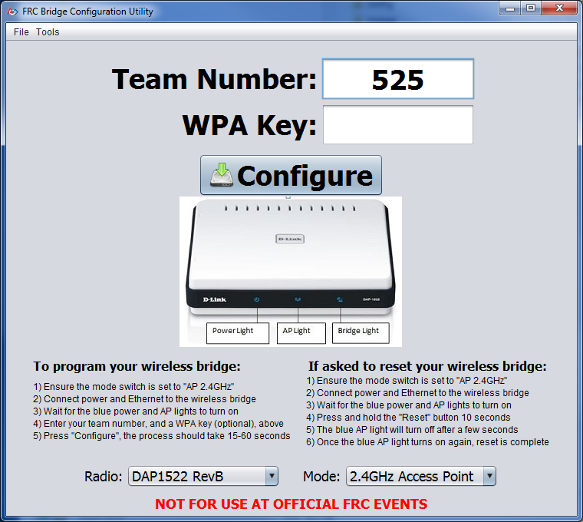
Bridge Configuration Utility

Slide 18
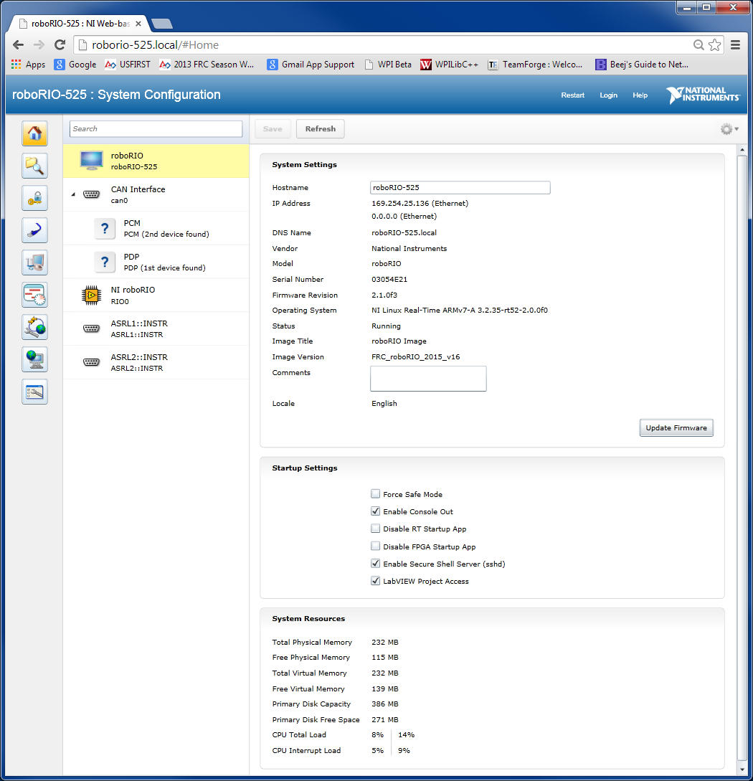
RoboRIO Web Dashboard

Slide 19
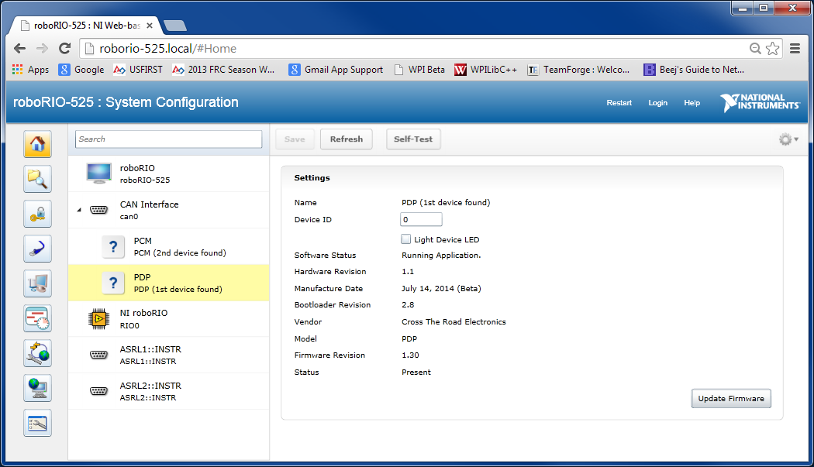
RoboRIO Web Dashboard

Slide 20
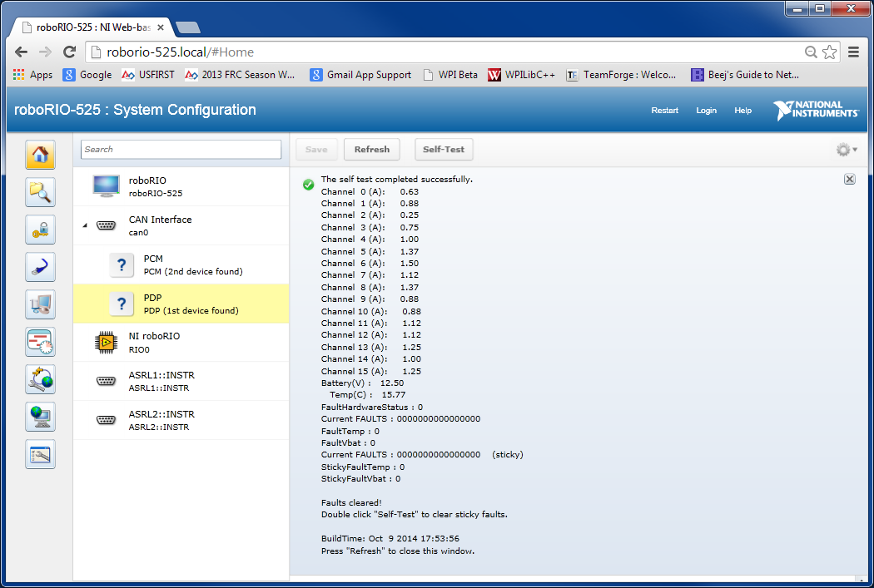
RoboRIO Web Dashboard

Slide 21
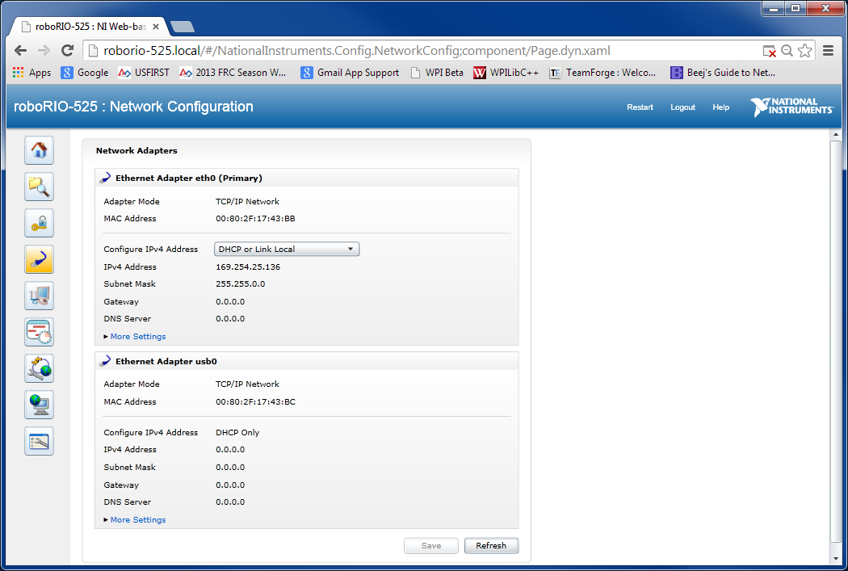
RoboRIO Web Dashboard

Slide 22
2015 Driver Station
ViewMenu
PC: Battery
CPU %
Battery Voltage
Chart
Log
Menu
Operation
Messages
Operation
Diagnostics
Settings
USB
CAN
Messages
Charts
Both

Slide 23
2015 Driver Station
Operation
Chart
Diagnostics
Messages + Chart
Reboot
Restart

Slide 24
2015 Driver Station
Settings
Messages
USB
Messages
6 - Joysticks
Test for Joystick Axes and Buttons

Slide 25
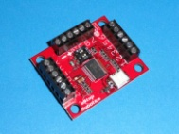
DS Deleted Features
eStop Robotics: CCI
No Kinect
No Cypress I/O
No User Messages

Slide 26
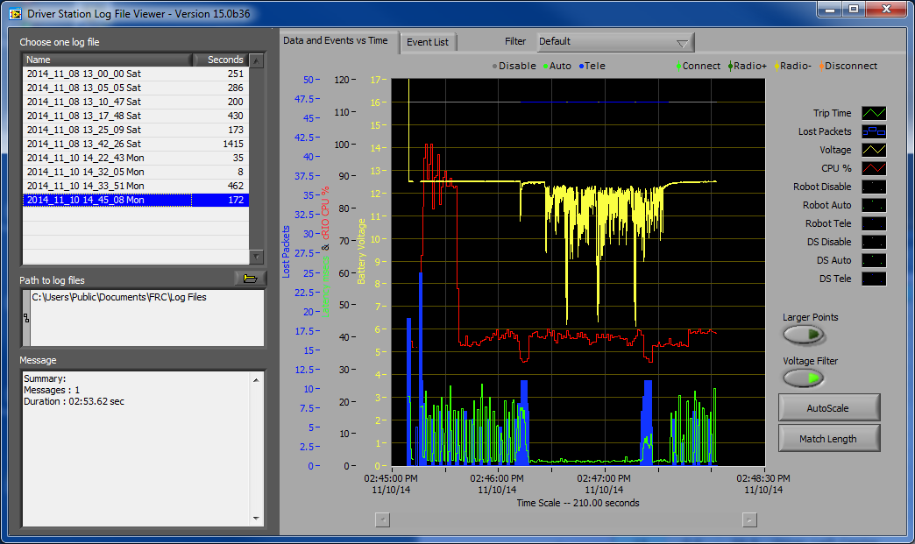
Driver Station Log Viewer

Slide 27
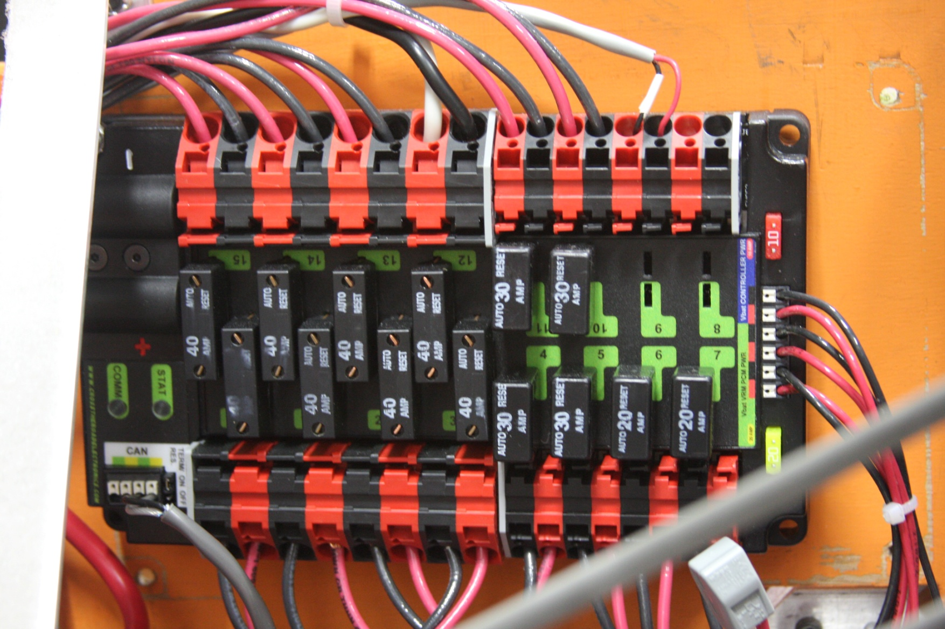
Installed PDP

Slide 28
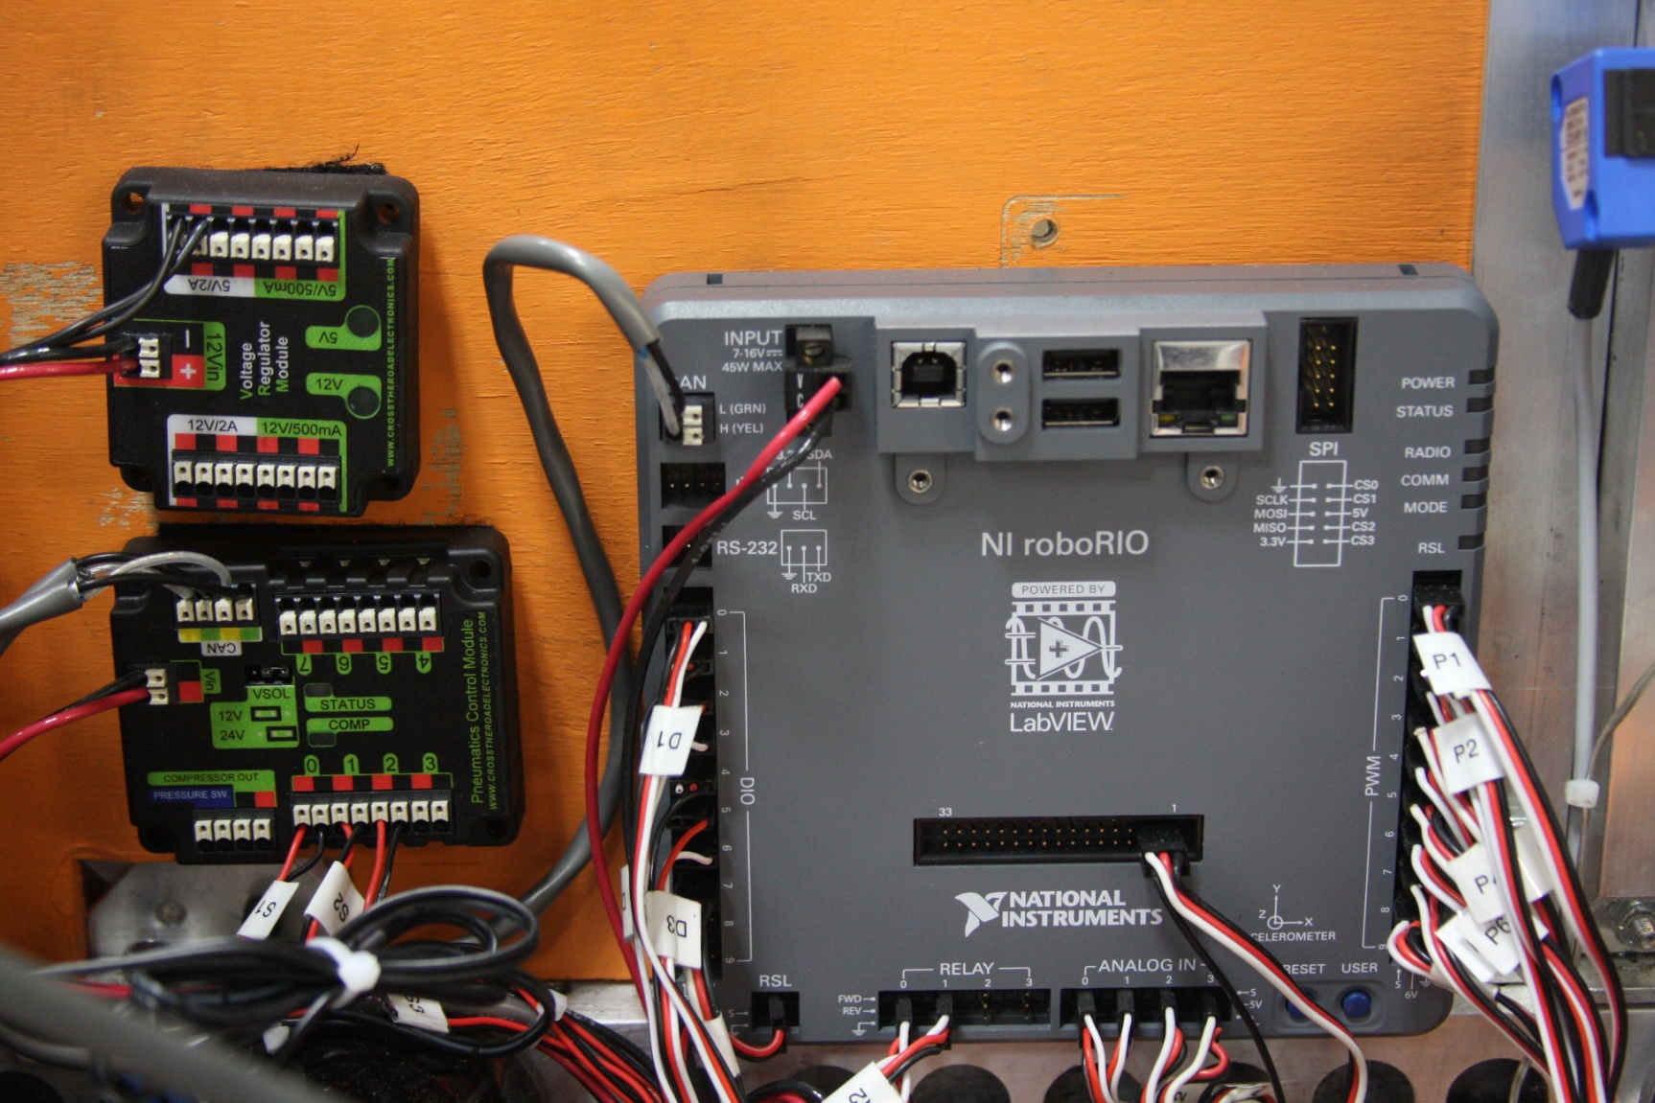
Installed RoboRIO

Slide 29
PDP Data Charting
20 hz Capture Rate

Slide 30
PDP Charting
20 hz Capture Rate

Slide 31
PDP Charting

Slide 32
Feature Changes
Zero-based input/output channel numbering
Class: +Additions, -Deletions, *Changes: (C++ and Java)
+BuiltInAccelerometer -AnalogModule *AnalogAccelerometer
+PowerDistributionPanel -DigitalModule *AnalogInput
+AnalogOutput -DriverStationEnhancedIO *Compressor
-DriverStationLCD *IterativeRobot (No SetPeriod)
-Kinect
Analog-to-Digital Convertor
cRIO: -10v to +10v 12-bit 0 - 1023 (at 5v)
roboRIO: 0 to +5v 12-bit 0 - 4095
Brownout Protection
PWM outputs disabled when voltage drops below 6.50v (Restored at 7.50v)
DIO power turned off when voltage drops below 6.25v (Restored at 6.60v)
Eclipse for C++ and Java Code Development
RoboRIO mDNS: roboRIO-team.local (roboRIO-525.local)

Slide 33
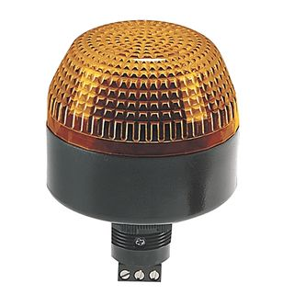
Robot Signal Light
2014 Signals
STATUS | CONDITION
OFF | Robot not booted up
ON | Autonomous Enabled
ON with OFF blink every 1.5 s | Teleop Enabled
ON 900 ms, OFF 900 ms | System Disabled
ON 200 ms, OFF 900 ms | Low Battery or No User Code
ON 200 ms, OFF 200 ms | System Error
2015 Signals
STATUS | CONDITION
OFF | Robot Off
ON | Robot Disabled
BLINKING | Robot Enabled

